Slide 1
Time Series Forecasting of Electrical Energy Consumption
Notes:
Good evening. My capstone project is to use time series to analyze and forecast electrical energy consumption. It may help energy companies predict the peak demand for electricity and then prepare corresponding installation maintenance plan or more schedule details.
The dataset in this project is from Kaggle, and it records over 10 years of hourly energy consumption of American Electric Power, a company delivers electricity to more than five million customers in 11 states.

Slide 2
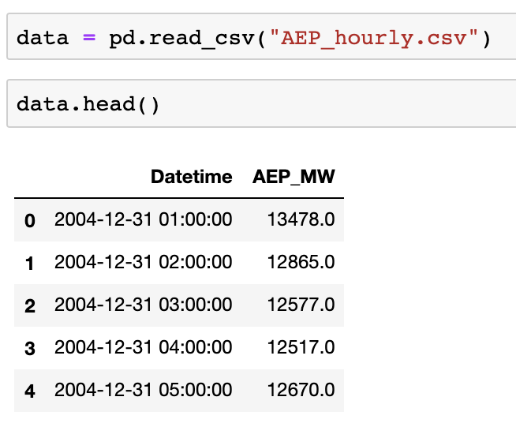
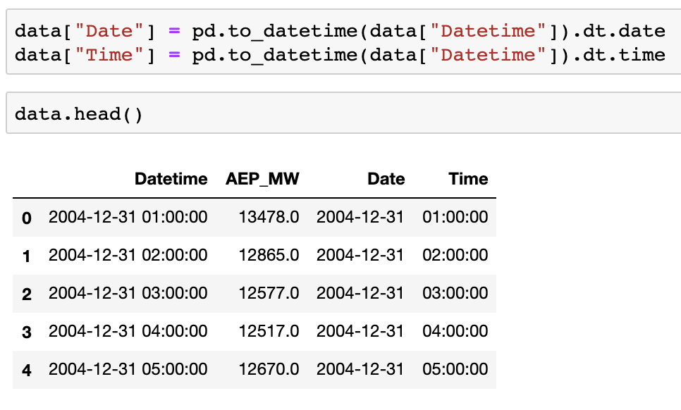
The Data and Data Preprocessing
Notes:
A time series is a sequence where a metric is recorded over regular time intervals. Depending on the frequency, a time series can be of yearly, monthly, weekly, daily or hourly. This project focus on monthly and hourly time series data.
First thing is to load the data file. The data was downloaded from Kaggle as CSV file. This is how the data frame looks like
Then convert the column "Datetime" to datetime data type. I also separate the date and time in two different columns.

Slide 3
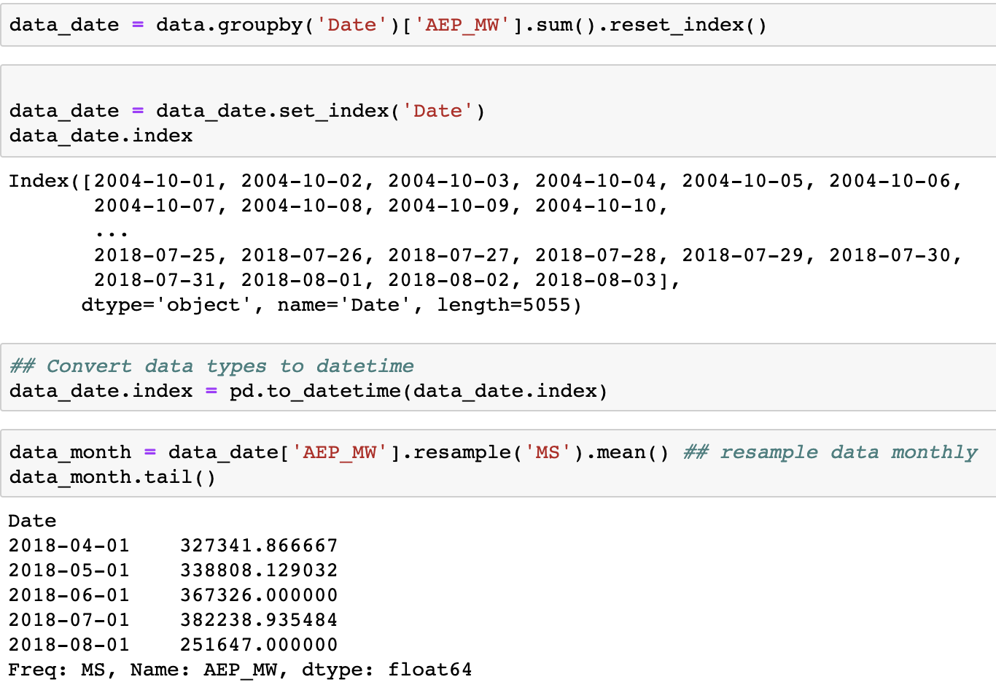
The Data and Data Preprocessing
Notes:
The hourly electricity consumption was grouped into a corresponding date. Indexing with Time Series Data
is also necessary in time series analyze because index has the character of uniqueness, it can ensure the uniqueness of each record in each date.
Finally resample the hourly time series data into monthly.

Slide 4
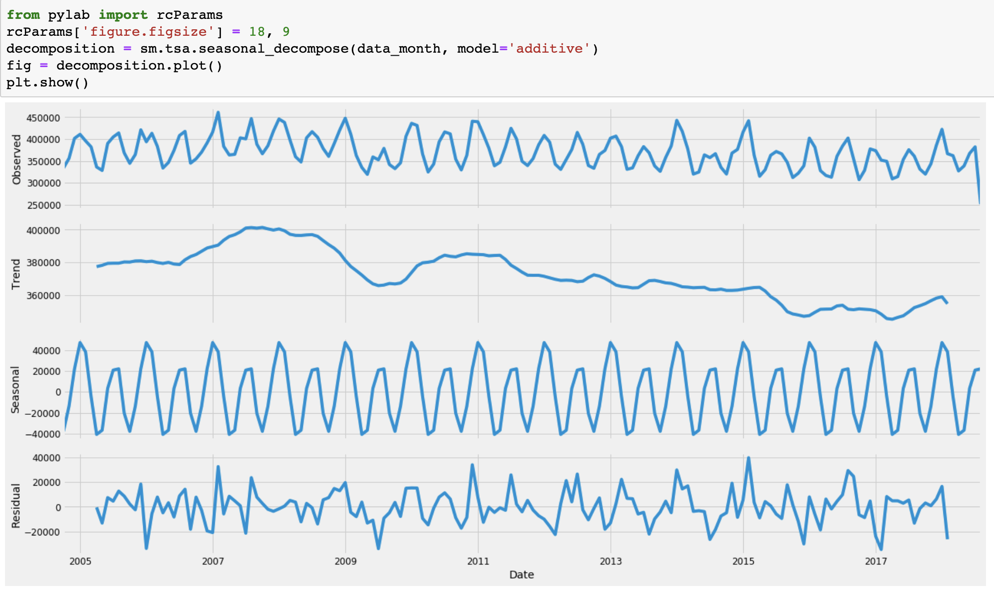
Notes:
This is the decomposition of time series data plot, there is a trend. The time series data looks not stationarity. Let's check the auto-correlation plot

Slide 5
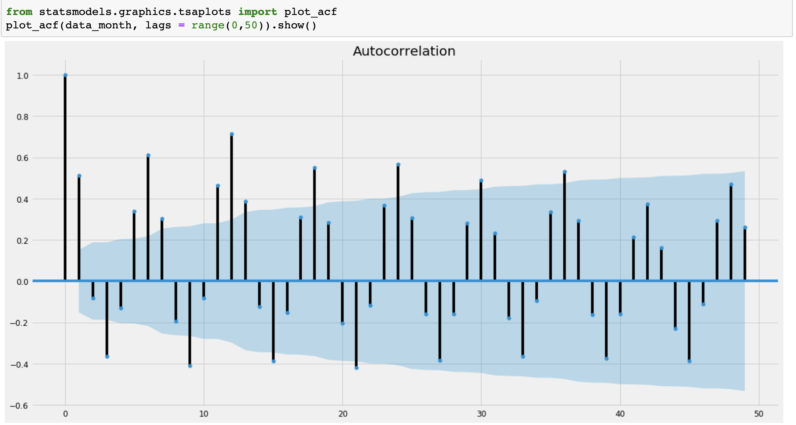
Notes:
The autocorrelation doesn't have either "cut off" or "tail off" characteristics which are characters of stationarity.

Slide 6
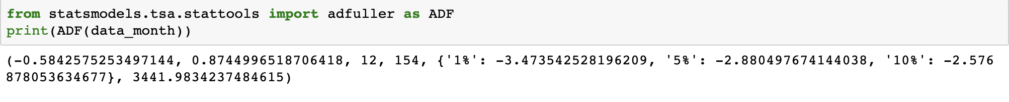
Augmented Dickey–Fuller test
Notes:
Let's tale a look on ADF test. (ADF) tests the null hypothesis that a unit root is present in a time series sample. that can cause problems in statistical inference involving time series models
The P-value is much larger than the significant level 0.05. The result reject the null hypothesis that unit root doesn't exist. The time series is not stable.

Slide 7
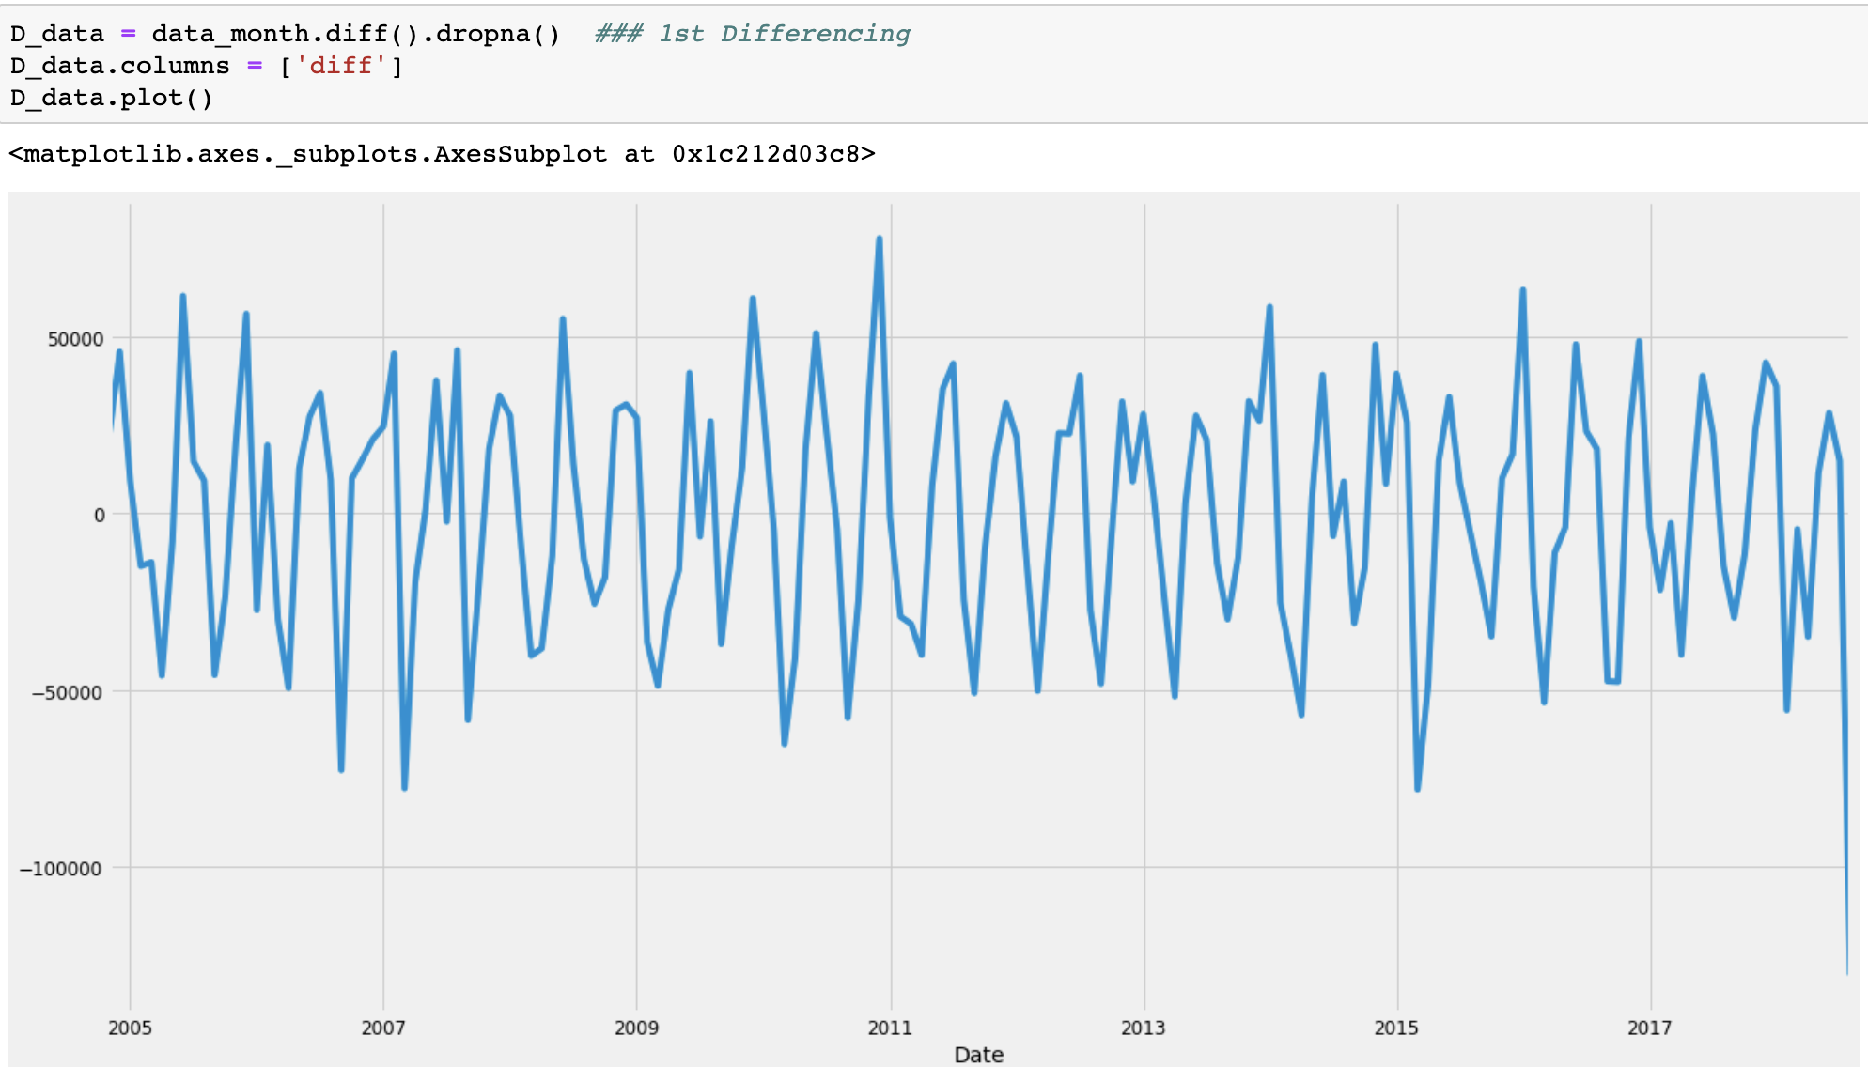
First-Differencing
Notes:
Since the time series sample is not stable, first-differencing was taken to try to make it stable for future modeling and prediction.

Slide 8
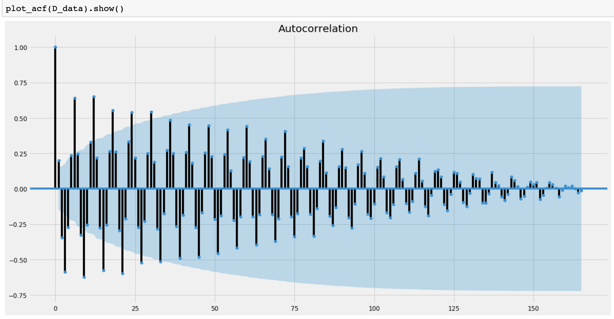
Notes:
After 1st differencing, the autocorrelation plot has obvious "tail off" Characteristics.

Slide 9
ADF Test Result
Notes:
The p-value in the ADF test is closed to zero. We can accept that the null hypothesis that unit root doesn't exist. The time series is stable.

Slide 10
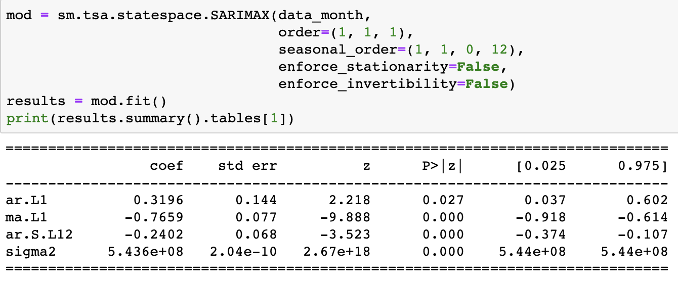
Fitting the ARIMA model
Notes:
Now we are building the ARIMA Model.
ARIMA, short for ‘Auto Regressive Integrated Moving Average’ is actually a class of models that ‘explains’ a given time series based on its own past values.
ARIMA is most commonly used method for time-series forecasting.
The table is the model summary. We can see that the p-value is less than 0.05. First-differencing has a good effect.

Slide 11
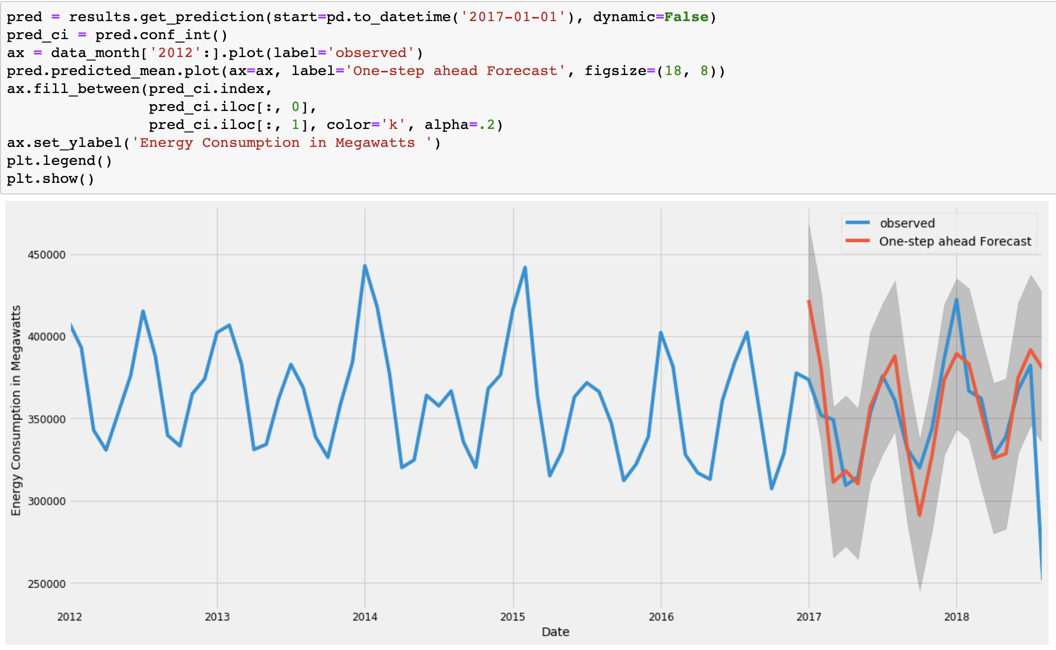
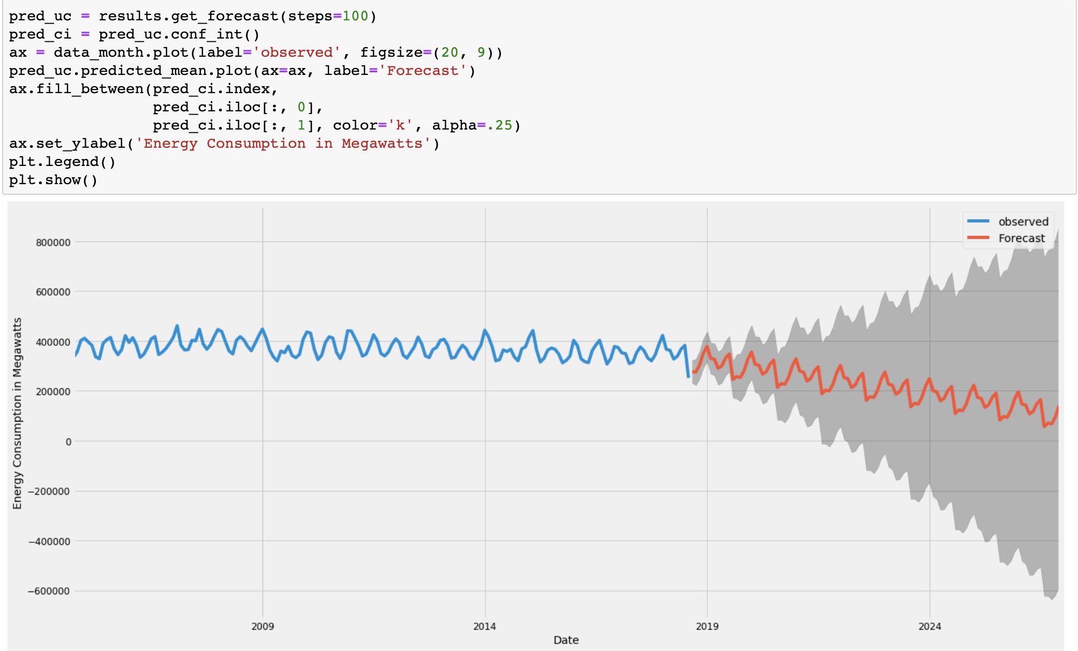
Validating forecasts
Notes:
The line plot is showing the observed energy consumption from 2012 to 2018 compared to the rolling forecast predictions. Overall, the forecasts align with the true values well.
The right line plot forecast future electricity consumption after 2018. The model clearly captured energy consumption seasonality. As the forecast further out into the future, it is natural for us to become less confident in our values. This is reflected by the confidence intervals generated by our model, which grow larger as we move further out into the future.

Slide 12
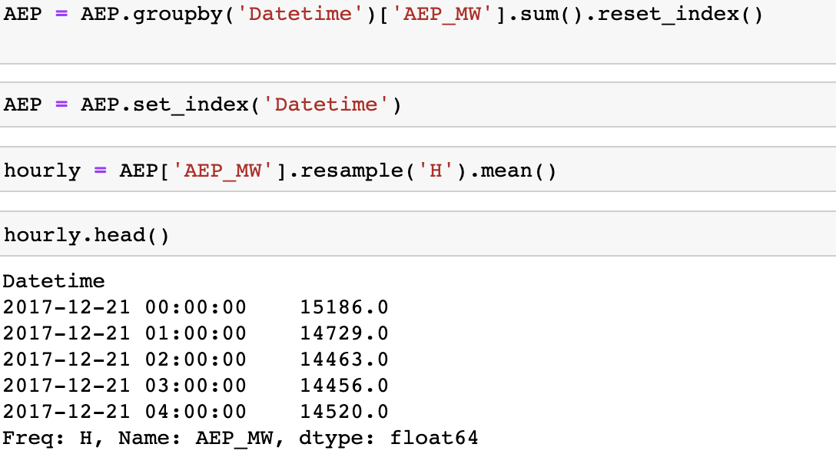
Preprocessing Hourly Time Series Data
Notes:
Let's move to hourly data.
Very similar like monthly data, but just resample to hourly.

Slide 13
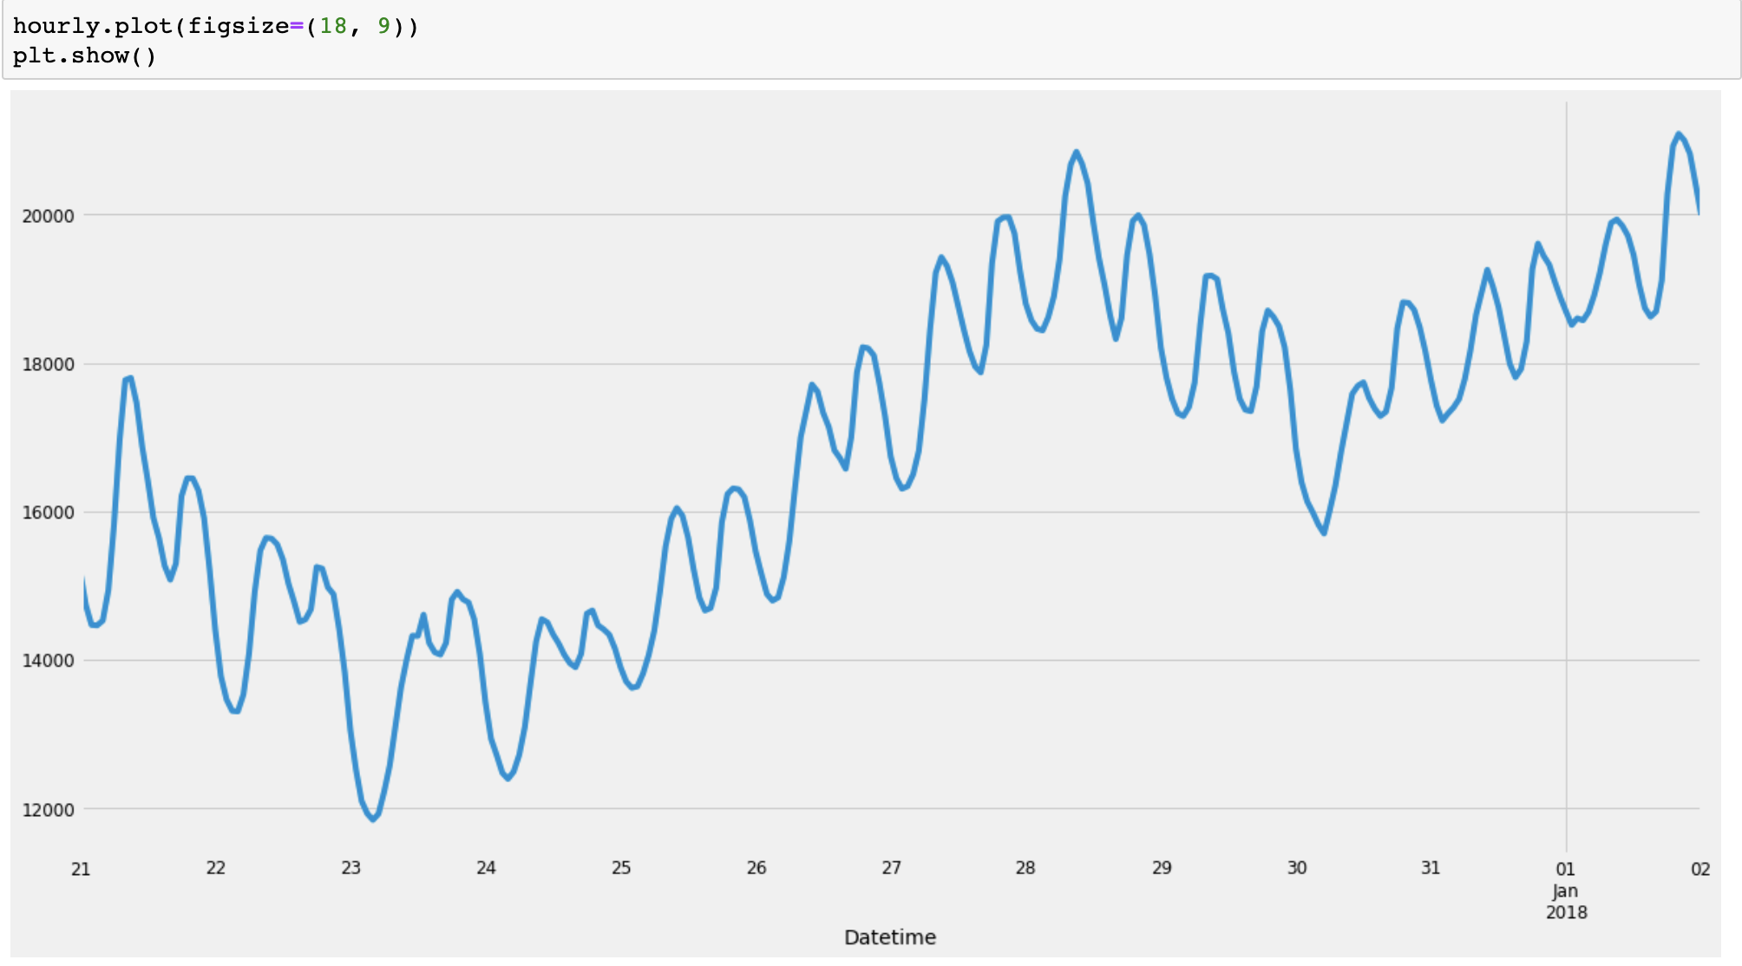
Visualizing Hourly Time Series Data
Notes:
This is the line plot of hourly time series data. There is an obvious trend. It's not stable.

Slide 14
Augmented Dickey–Fuller test
Notes:
This is the ADF test result after first-differencing. The p-value is closed to 0. We can accept that the root unit doesn't exist.

Slide 15
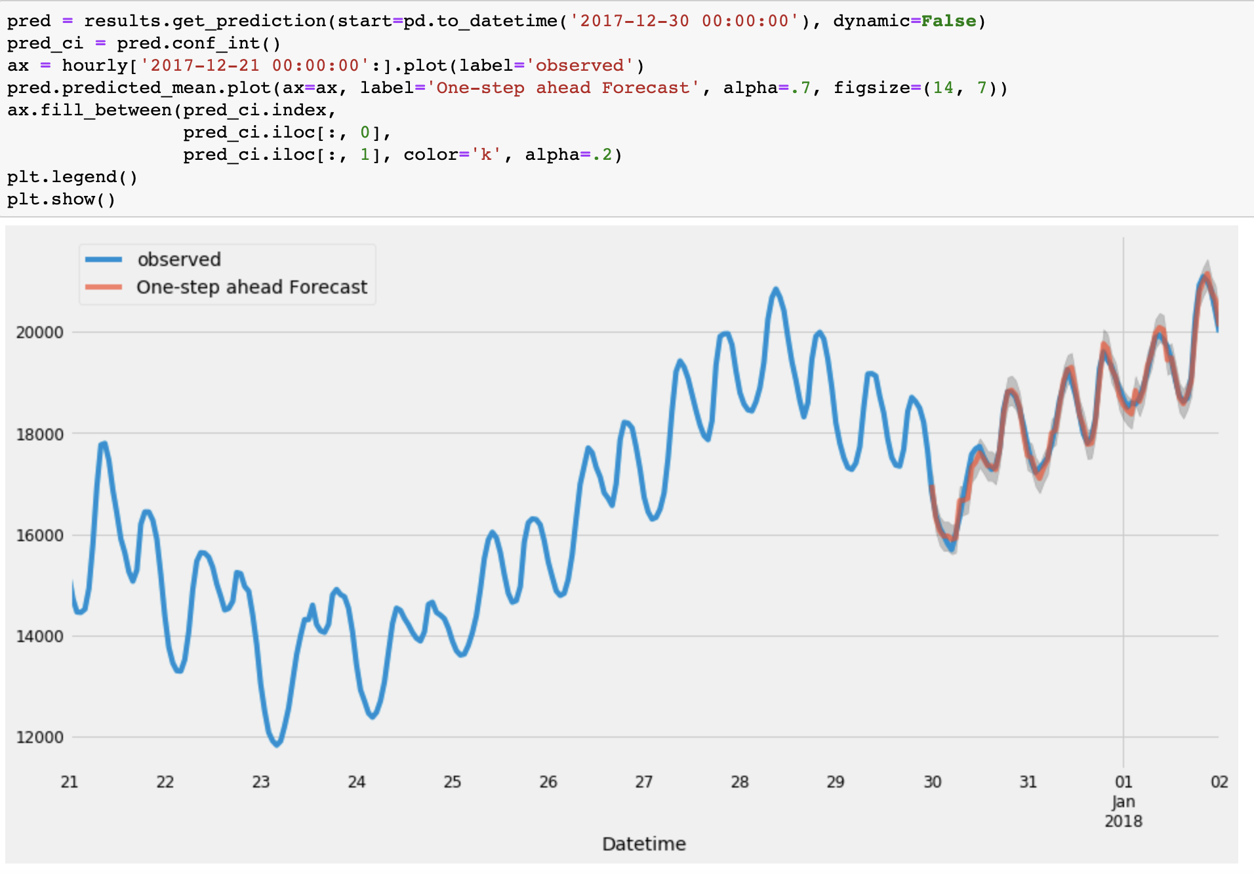
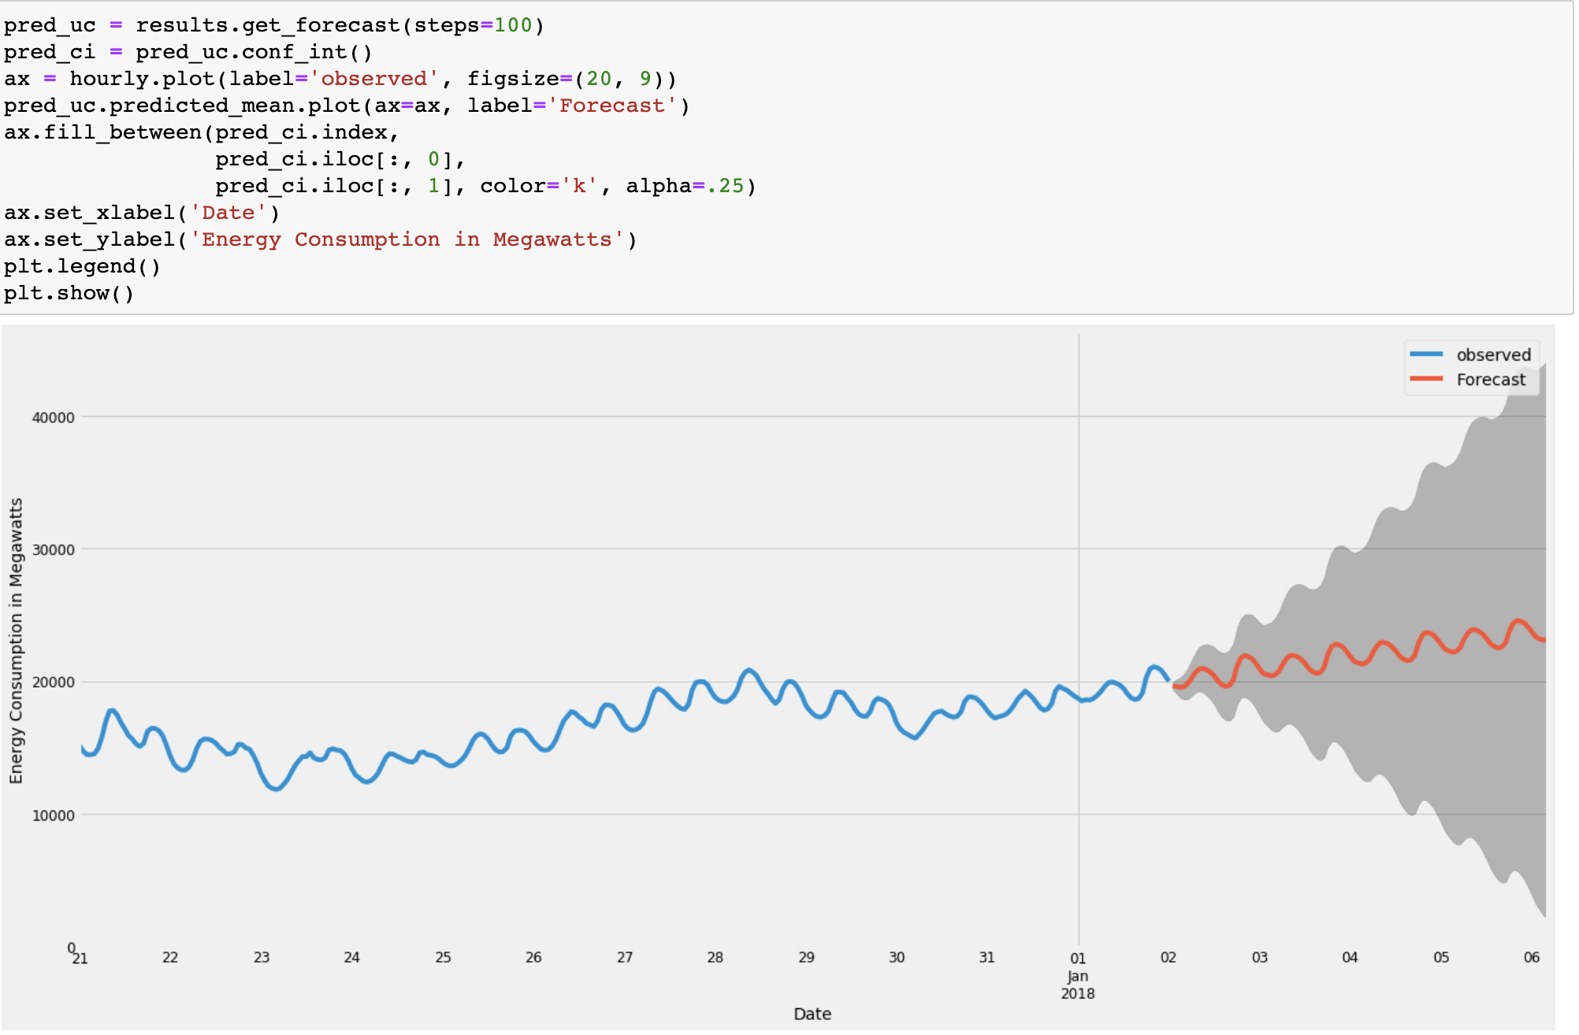
Validating forecasts
Notes:
The left line plot is showing the observed energy consumption from 2017-12-30 12am to 2018-01-02 12am compared to the rolling forecast predictions. Overall, the forecasts align with the true values well.
The right line plot forecasts future electricity consumption.
The model clearly captured energy consumption seasonality. As the forecast further out into the future, it is natural for us to become less confident in our values. This is reflected by the confidence intervals generated by our model, which grow larger as we move further out into the future.

